Slide 1

Presumed Open Data Data Science Challenge
Feb 2021

Slide 2


Presumed Open Data Data Science Challenge
Forecast
Solar
Optimise
Battery
Weather
DATA
Forecast
demand
Reduce Peak
SUB-STATION Demand

Slide 3
Content
Challenge Scenario / Aim
Tasks, Rules & Dates
Site Details
Data Sets
Constraints
Solution Scoping
Progress To Date / Next Steps
Appendix: Technical Research

Slide 4
THE CHALLANGE

Slide 5
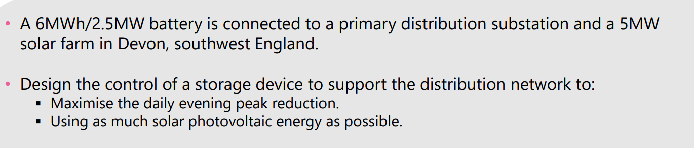
Scenario
AIM: Reduce Evening Demand over peak (3:30pm UTC to 9pm UTC) via battery discharge. Charge battery before 3pm UTC

Slide 6
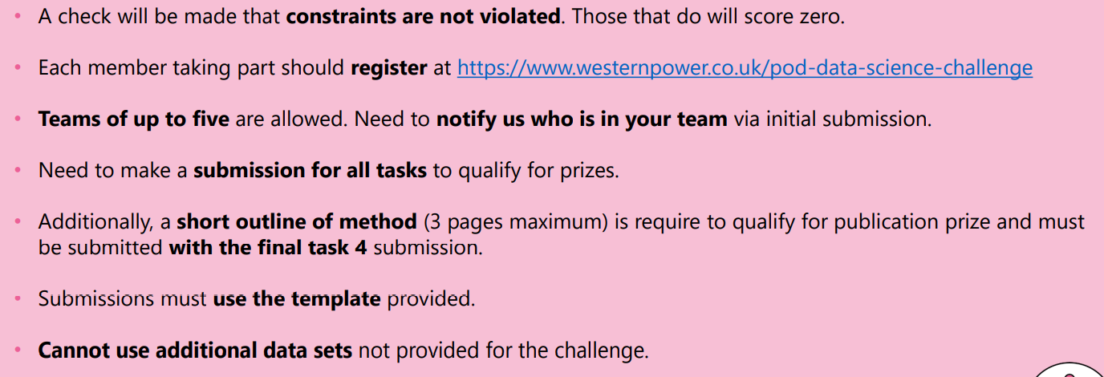
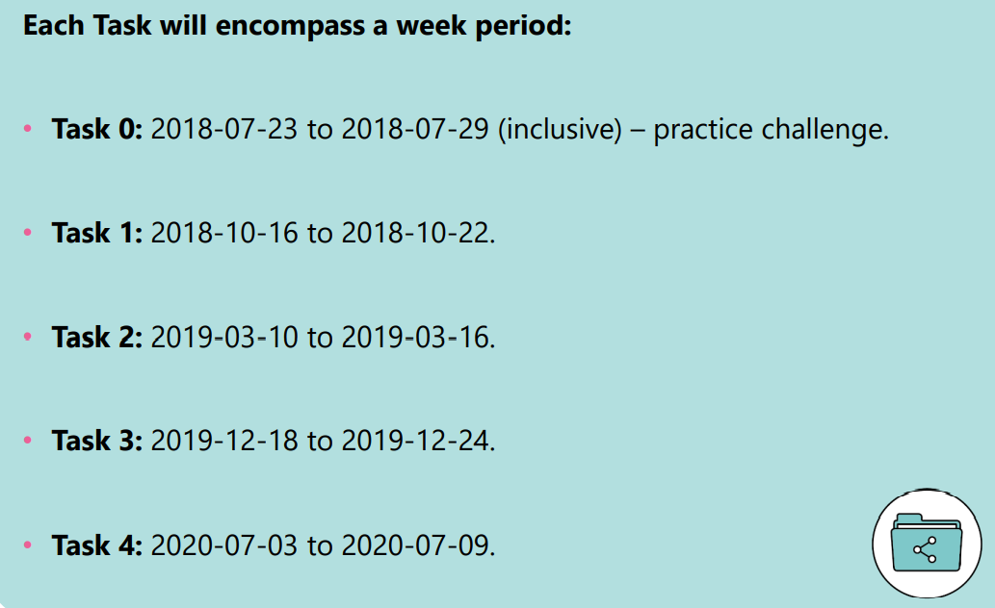
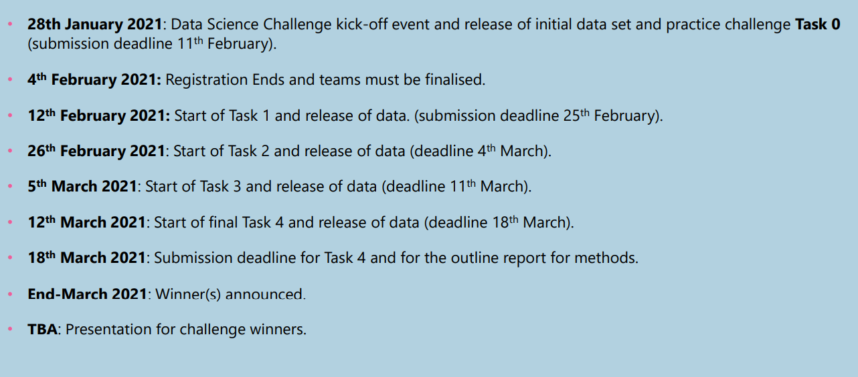
Tasks, Rules & Dates

Slide 7




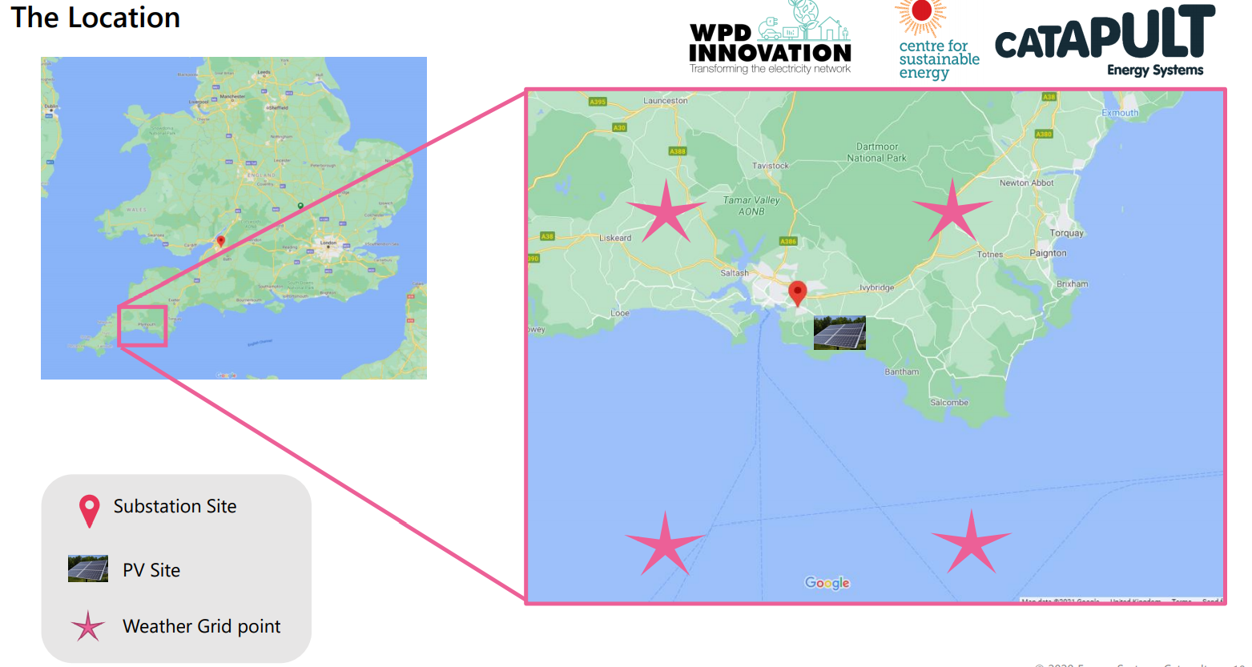
Site Details
Panel Temp
Irradiance
Solar Output
Site Demand = Solar – Battery Charge
Substation Demand
Charge
Discharge
SoC
6MWh / 2.5MW battery
5MW solar farm, Stentaway
Devon, southwest England
Substation
Six weather stations, four near substation PV – two are in the sea
Temp
Irradiance

Slide 8
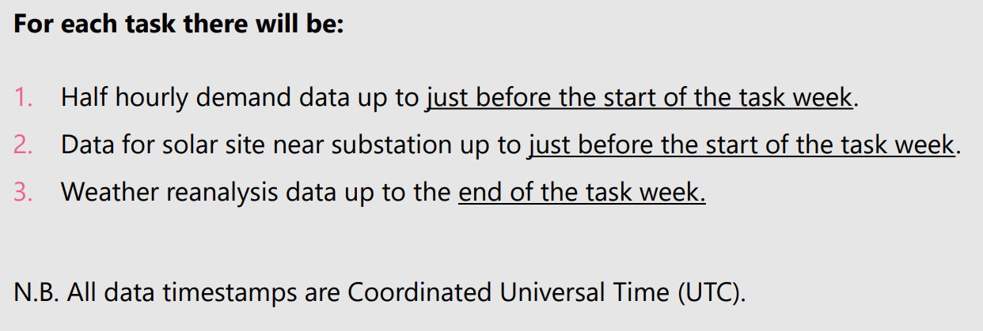
Data Sets
Substation HH Demand: Needs cleaning for Large Values, Constant Values, Missing Values. In UTC but demand follows local pattern. Available up to start of task week.
PV Generation (Needs cleaning for missing values) hh data in UTC for:
Average solar output (MW)
Average irradiance (Wm-2 )
Panel Temperature (Celsius)
Available up to start of task week.
Weather Forecast Data NASA’s MERRA-2
Hourly reanalysis data – i.e. reassimilated forecasts using current observations. ▪ Irradiance (Wm-2 ) ▪ Temperature (Celsius)
Six sites including four surrounding grid points of substation/PV site
Starting 1st January 2015
Up to End of Task Week

Slide 9
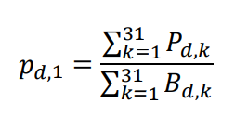
Constraints
Battery Import / Export (2.5MW): −2.5𝑀𝑊 = 𝐵𝑚𝑖𝑛 ≤ 𝐵𝑑,𝑘 ≤ 𝐵𝑚𝑎𝑥 = 2.5𝑀
Battery Capacity (6MWh): 𝐶𝑑,𝑘, (in MWh): 0 ≤ 𝐶𝑑,𝑘 ≤ 𝐶𝑚𝑎𝑥 = 6𝑀𝑊ℎ
total charge in the battery at the next time step 𝐶𝑑,𝑘+1 is related to how much is currently in the battery and how much charged within the battery at time k, i.e. 𝐶𝑑,𝑘+1 = 𝐶𝑑,𝑘 + 0.5𝐵𝑑,
Battery Charging (𝐵𝑑,𝑘 ≥ 0) is only allowed from midnight UTC to 3.30PM UTC (𝑘 = 1 𝑡𝑜 31)
Battery Discharging (𝐵𝑑,𝑘 ≤ 0) is only allowed from 3.30PM UTC to 9PM UTC 𝑘 = 32 𝑡𝑜 42
Battery must start empty at the start of each day in the test week. I.e. 𝐶𝑑,1 = 0 for 𝑑 = 1, … , 7.
Solar generation is always stored first, remainder from Grid:
𝐵𝑑,𝑘 ≥ 0 be the requested power to be charged into the storage device. If 𝑃𝑑,𝑘 𝑇𝑜𝑡𝑎𝑙 is the total PV average power generated by the solar then one of two scenarios occurs:
1. If 𝐵𝑑,𝑘 ≤ 𝑃𝑑,𝑘 𝑇𝑜𝑡𝑎𝑙, then all the energy comes from the solar generation.
2. If 𝐵𝑑,𝑘 > 𝑃𝑑,𝑘 𝑇𝑜𝑡𝑎𝑙, then 𝑃𝑑,𝑘 𝑇𝑜𝑡𝑎𝑙 is stored in the battery from solar generation and 𝐵𝑑,𝑘 − 𝑃𝑑,𝑘 𝑇𝑜𝑡𝑎𝑙 comes from the grid.
proportion of this energy over the day is given by:

Slide 10
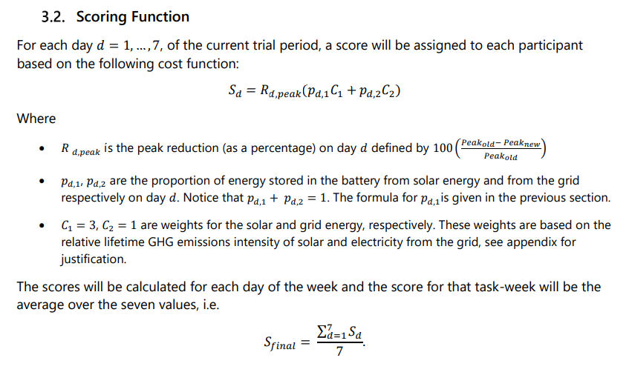
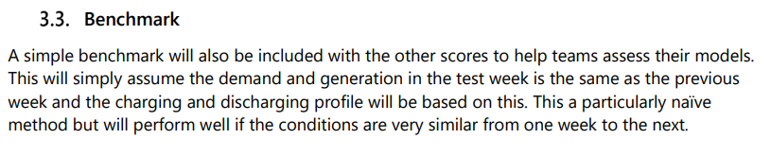
Scoring Function
Reduce Peak Demand
Maximise Charging from Solar sine it is consider less carbon intensive than charging from Grid

Slide 11
Implementation
Progress To Date

Slide 12
Solution Functional Scoping
Data Load and Storage
Data Cleansing, Categorisation and Enrichment
Solar Forecasting
Demand Forecasting
Battery Optimisation
Results Storage
Results Validation
Self Scoring
Results Visualisation
Results Export
Visualise+ Explore Source Data
Visualise+ Explore Forecast Data
Visualise+ Explore Optimisation Results
MODEL BACK TEST
RESULTS VALIDATION
SELF SCORE
Historic Demand
Raw Data Store
DEMAND FORECAST MODEL
Battery Optimisation Solver
Historic PV
Data Cleanse
Store Forecasts
Store Optimisation Results
Weather Forecast
PV MODEL
Asset Static Data - Battery
Asset Static Data - PV
Weather Station Locations

Slide 13










Technical Design
Task Files
Weather
PV
Demand
Enrichment Files
OPTIMISATION SOLVER (ITERATIONS)
Calendar
Increase Automation and complexity by Task
Prep Scripts
Asset Static
Data Merge
Demand Forecast
Model
PV Forecast
Model

Slide 14
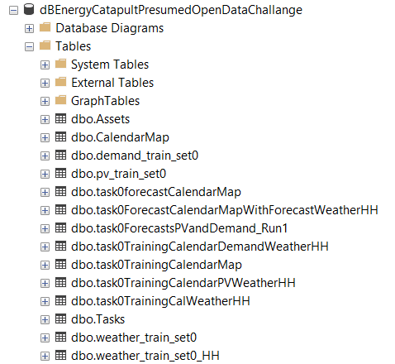
Database Design
Assets
Asset ID*
Name
Location Name
Location Long
Location Lat
Type (BATTERY, SOLAR, SUBSTATION, WEATHER STATION
Capacity MWh
Power MW
Created Date
Created By
CalendarMap
dateTimeUTC
Clock changes
Mapping to Local
Settlement Period Mapping
List by weeks
WD / NWD
Holidays
Demand Training Data
dateTimeUTC
demand_MW
Forecast Results by Task
dateTimeUTC
ForecastDemandMW
ForecastPVMW
taskName
Optimisation Results by Task
TBC
PV Training Data
dateTimeUTC
Irradiance_Wm-2
pv_Power_MW
panel_temp_C
Weather Forecast
dateTimeUTC
Tasks
Task
From Date
To Date
Weather Training Data (HOURLY)
dateTimeUTC
6 * Temp Forecast
6* Solar Forecasts
Weather Training Data (HH)
dateTimeUTC
6 * Temp Forecast
6* Solar Forecasts

Slide 15
OUTPUTS
Progress To Date

Slide 16
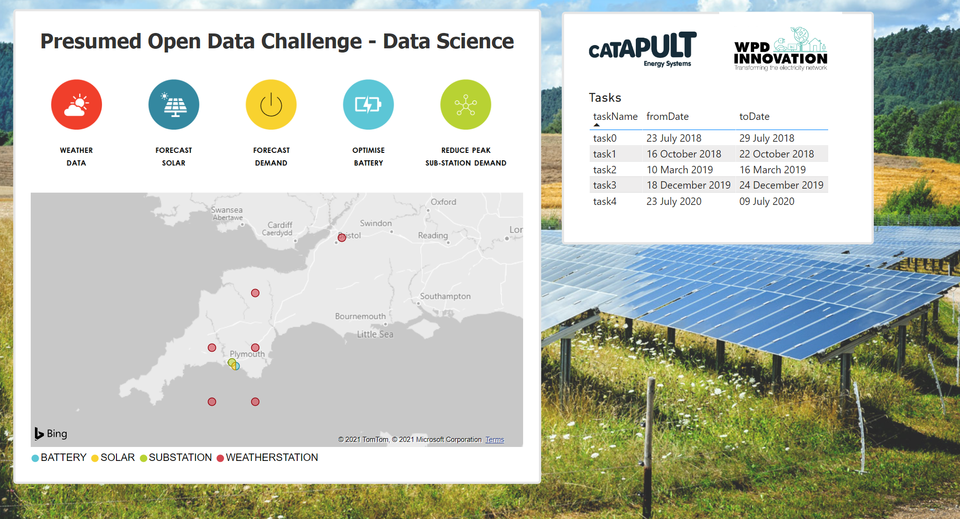

Slide 17
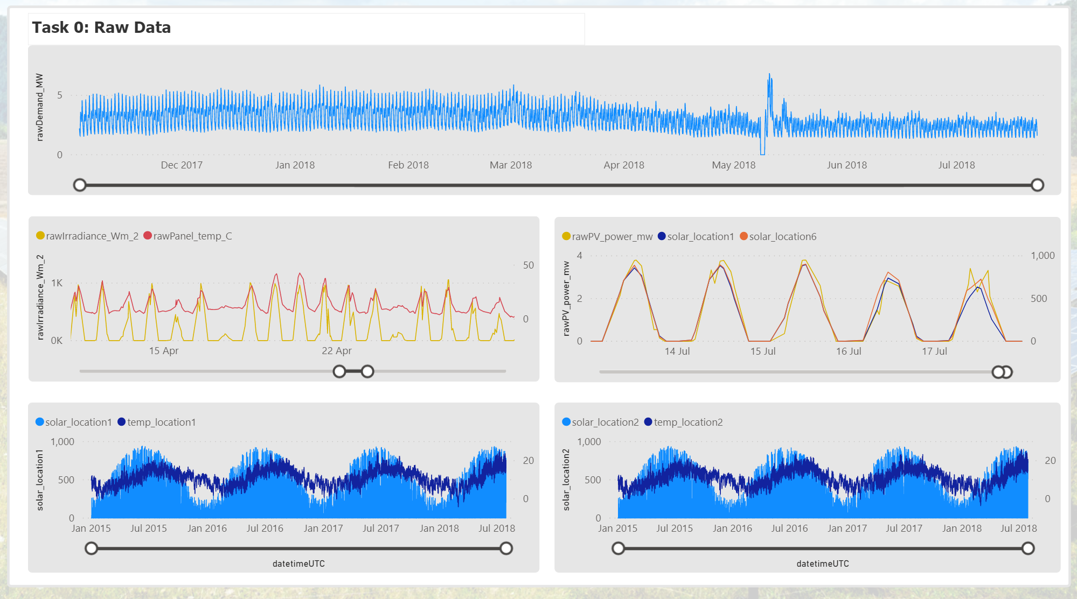

Slide 18
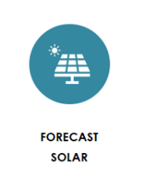
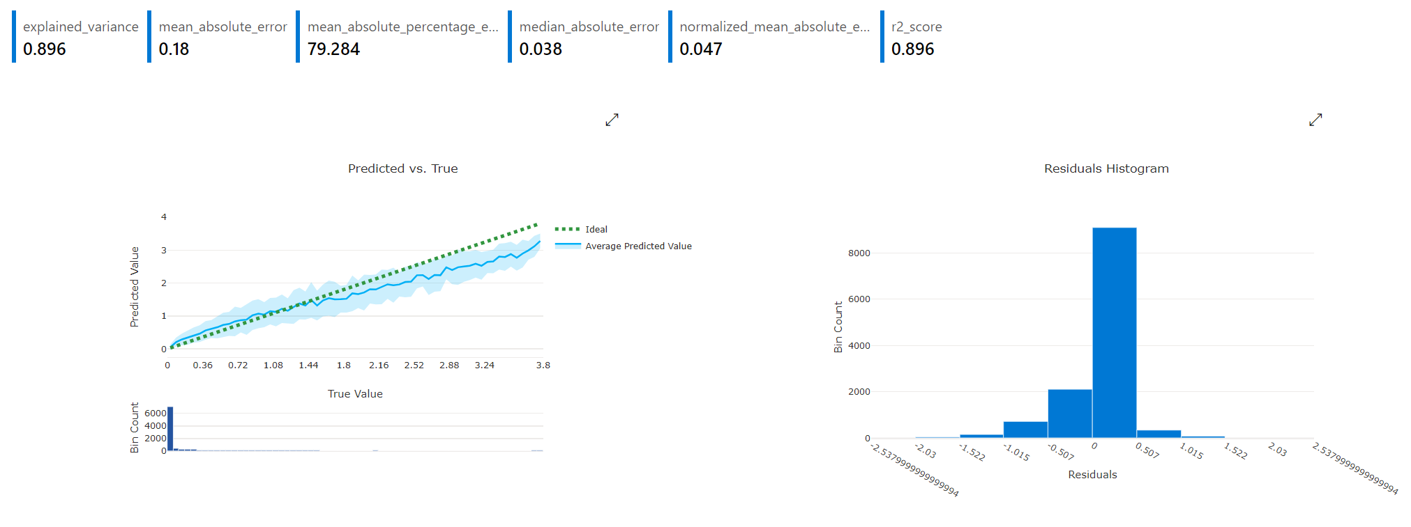
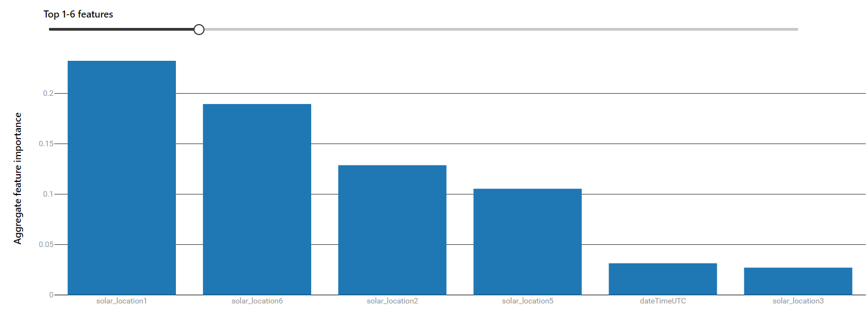
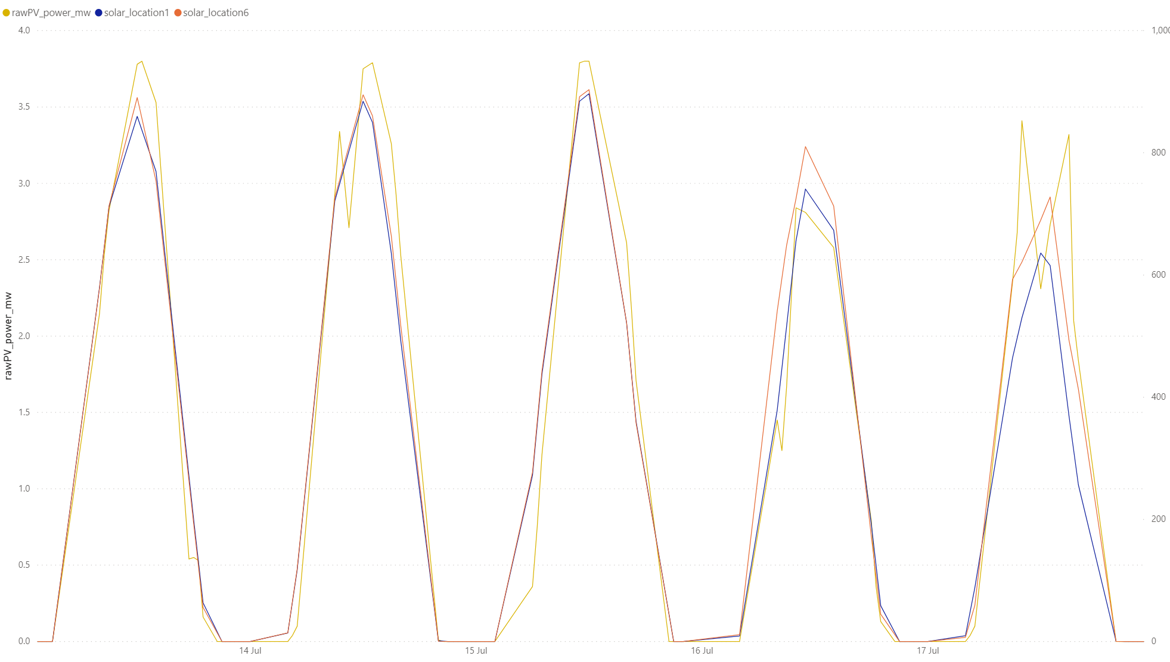
Solar Forecast Model V1

Slide 19
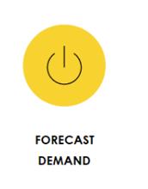
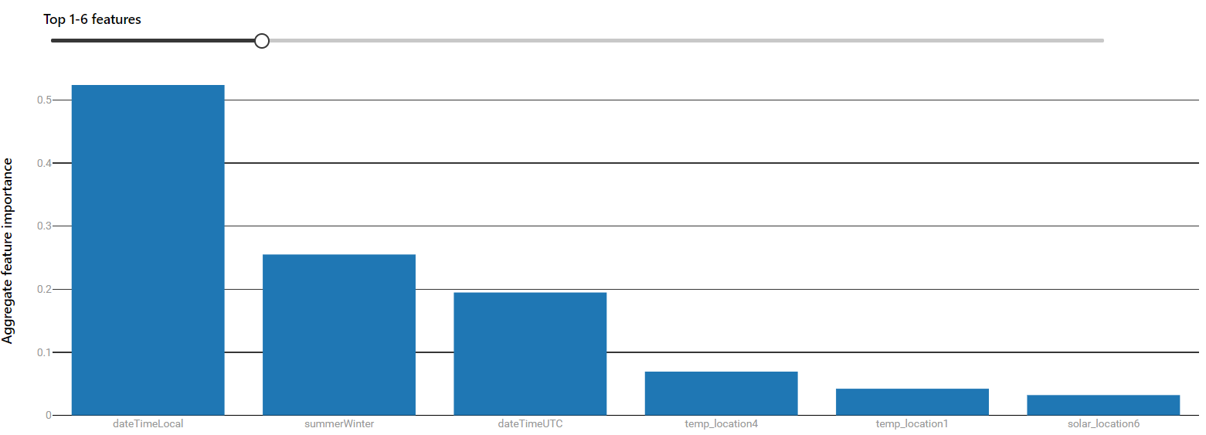
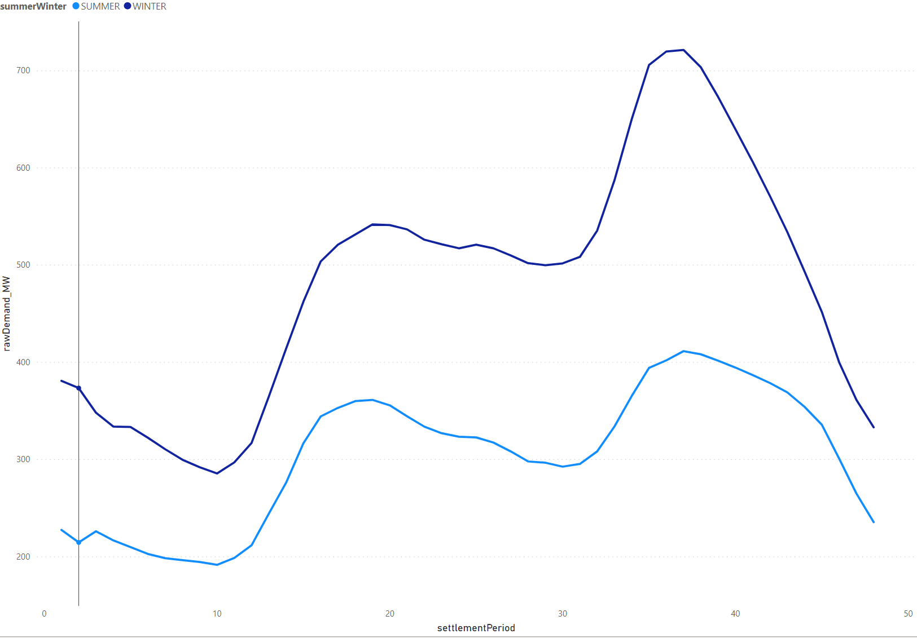
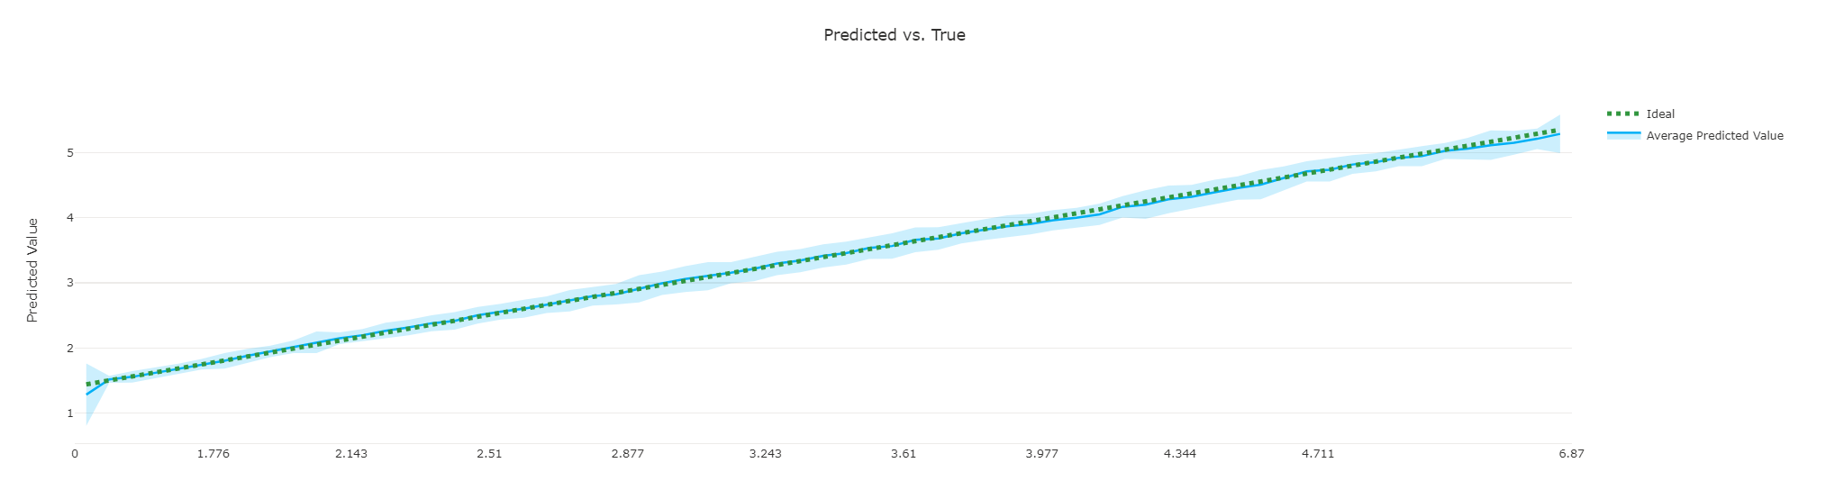
Solar Forecast Model V2

Slide 20
Next Steps
Build Team (DONE)
Get Everyone access to tools and data (IN PROGRESS)
Generate Task 0 Forecast (DONE)
Identify Optimisation Solver Approach (MANUAL INITIALLY FOR LEARNING)
Optimise for Task 0
Create Task 0 submission

Slide 21
Appendix 1 – Architecture Research

Slide 22
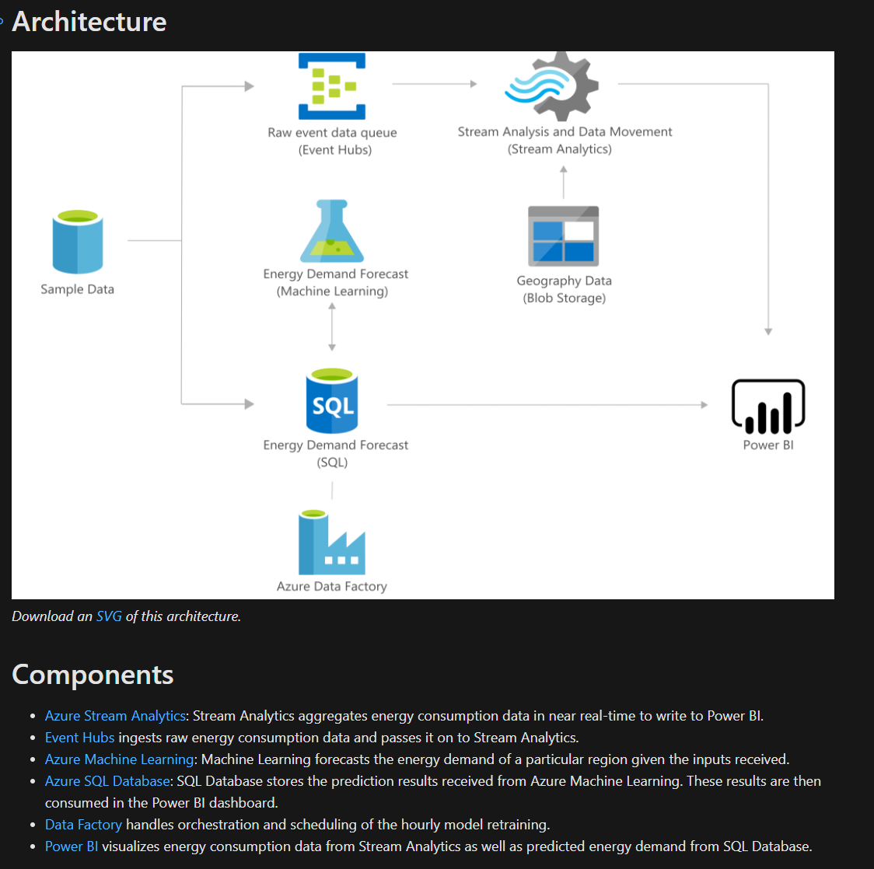
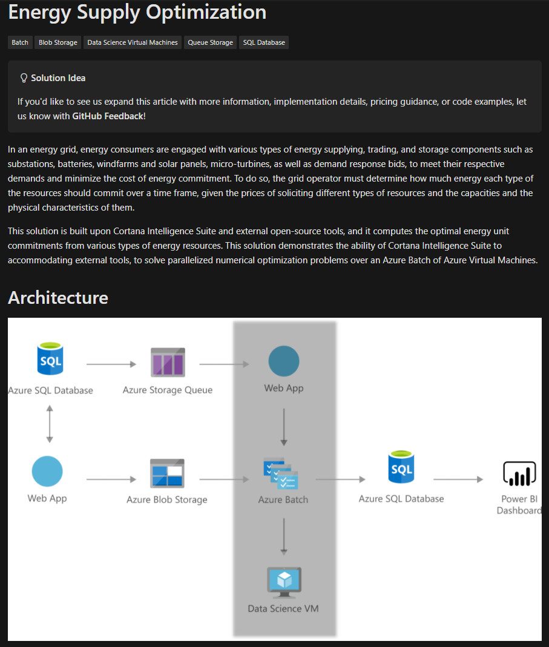
Azure Architecture Templates

Slide 23
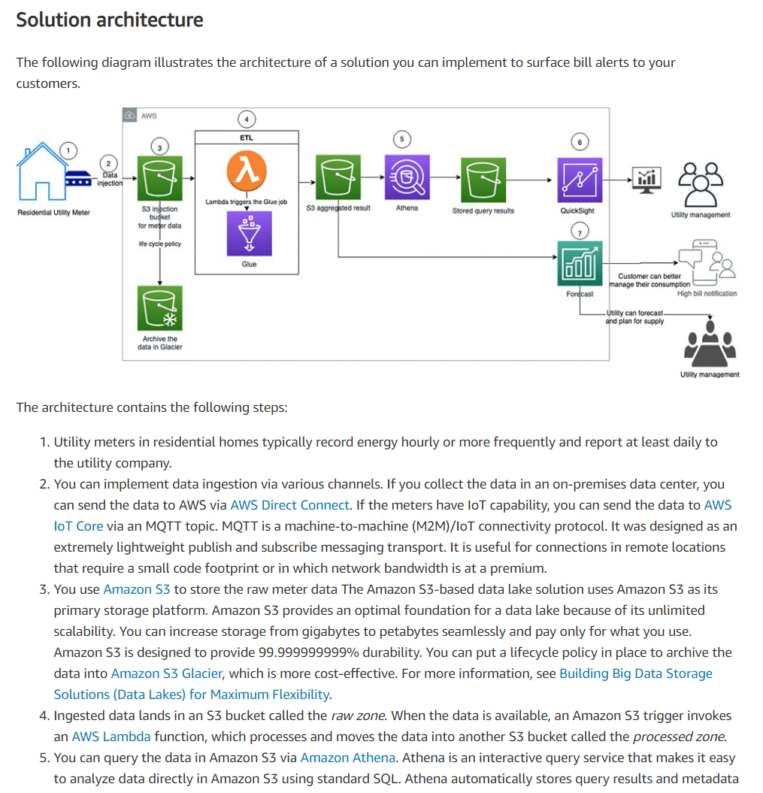
AWS Architecture Templates

Slide 24

Python Optimisation

